Slide 1


ESP32 - Cam Enhanced Surveillance Robot System using Custom Mobile Application
Developed by SANJAY KUMAR S with the guidance of
ANANDA SARAVANAN S M.Sc., M.Phil., NET [Assistant Professor],
Department of Electronics,
RVS College of Arts and Science, Coimbatore.

Slide 2
Abstract
This project introduces a surveillance robot using the ESP32-CAM board and a mobile application.
2. The ESP32-CAM development board with OV2640 2 Mega Pixel camera, Wi-Fi connectivity and a robot chassis equipped with 4 DC gear motors and 65mm wheels for mobility.
3. Function:
Enables mobile surveillance with clear video capture.
Controlled via a web interface mobile application hosted on the ESP32-CAM board.
Allows 360-degree movement control, live video streaming, and snapshot capturing.
4. Applications:
Home security enhancement.
Remote location monitoring.
Industrial surveillance.
5. Advantages:
Cost-effective solution.
Easy-to-use interface.
Provides convenient remote monitoring capabilities.

Slide 3
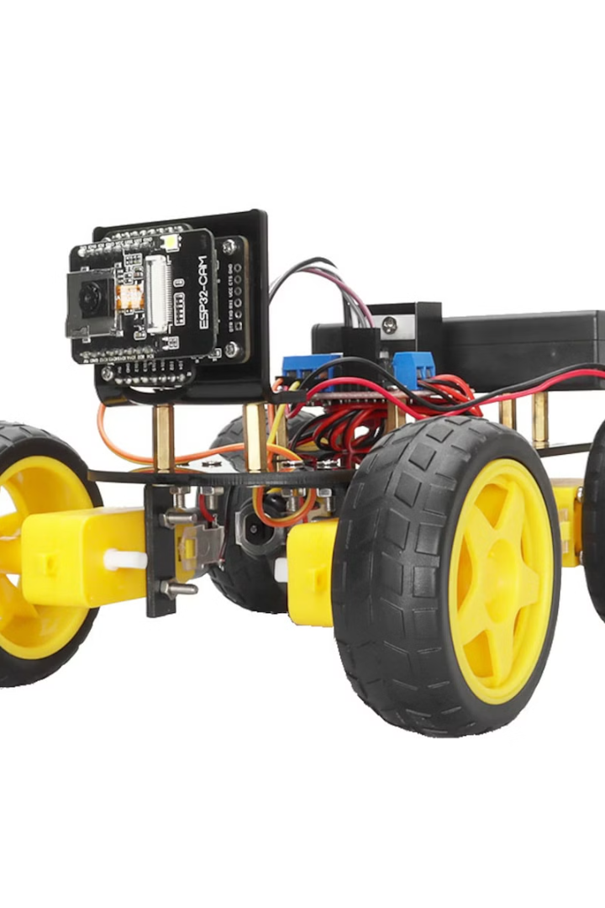
Overview
Introduction
Block Diagram
Circuit Diagram
Process Sequence System
Application using MIT App Inventor
Conclusion
Future Enhancement

Slide 4
Introduction
1. Objective:
Create a smart surveillance robot by using ESP32-CAM technology.
Empower the robot with wireless visual data capture and transmission.
2. Key Features:
Wireless visual data capture and transmission via ESP32-CAM.
Easy user control through the custom mobile application and smart functionalities.
3. Goal:
Develop a smarter and more accessible surveillance robot.
Push the boundaries of surveillance technology.
Enhance security measures with advanced features.
4. Significance:
Addresses the growing need for better security solutions.
Represents a significant advancement in surveillance robotics.
Offers potential for improved surveillance capabilities and ease of use.

Slide 5
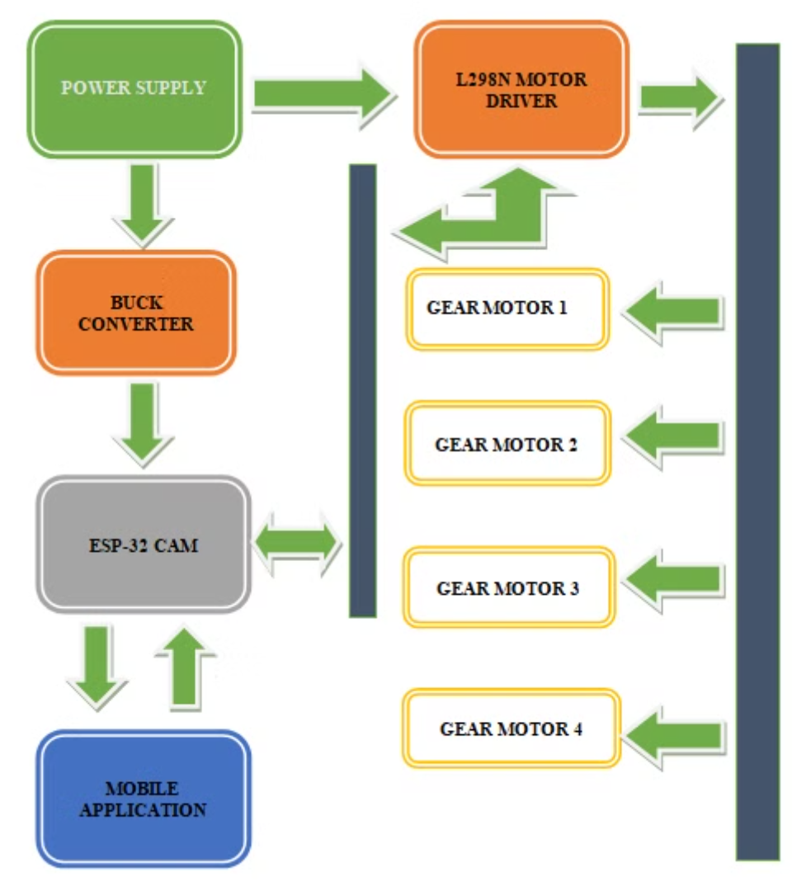
Block Diagram
In this block diagram, there is five major blocks.
The main block is ESP32 – Cam and Mobile Application.
The ESP32 – Cam block connects to the 3 major blocks called Buck convertor, Motor Driver and Mobile Application.
The Mobile Application block and ESP32 – cam block that interact each other for a data transmission and robot control.
Every blocks are connected to the Power Supply block to the stable performance.

Slide 6
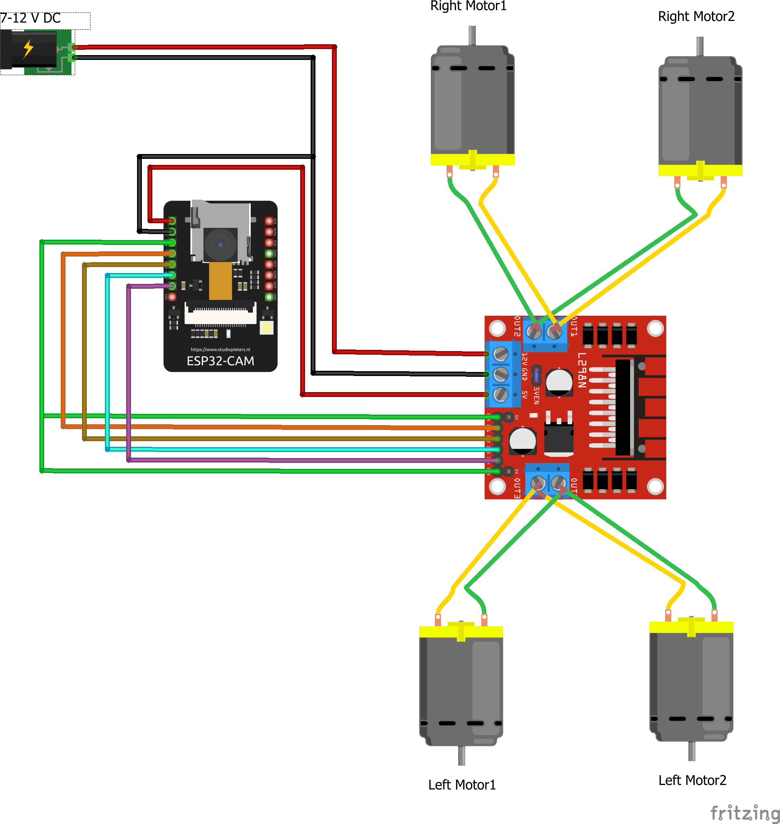
Circuit Diagram
In this circuit diagram, there is ESP32 – Cam, L298N Motor Driver, Gear Motors and Power Supply.
The Motor Driver have 4 Out’s for connecting motors [OUT1, OUT2, OUT3, OUT4] and power supply pins.
And also having ENABLE A, ENABLE B, IN1, IN2, IN3 and IN4 pins respectively.
The ENABLE A and ENABLE B pins are connected to the IO12 of the Cam Module.
And the IN1, IN2, IN3, IN4 are connected to the IO13, IO15, IO14 and IO2 of the Cam Module.
+5V power supply is given to the ESP32 – Cam.

Slide 7
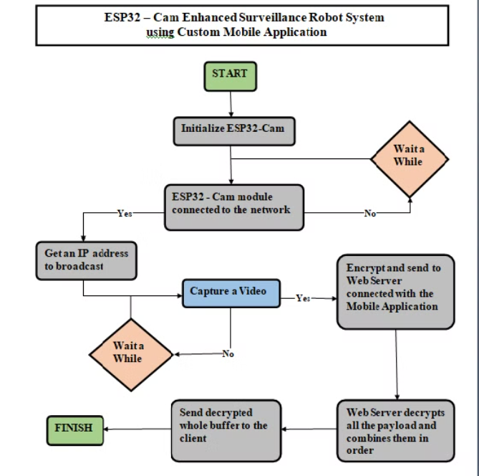
Process Sequence System

Slide 8
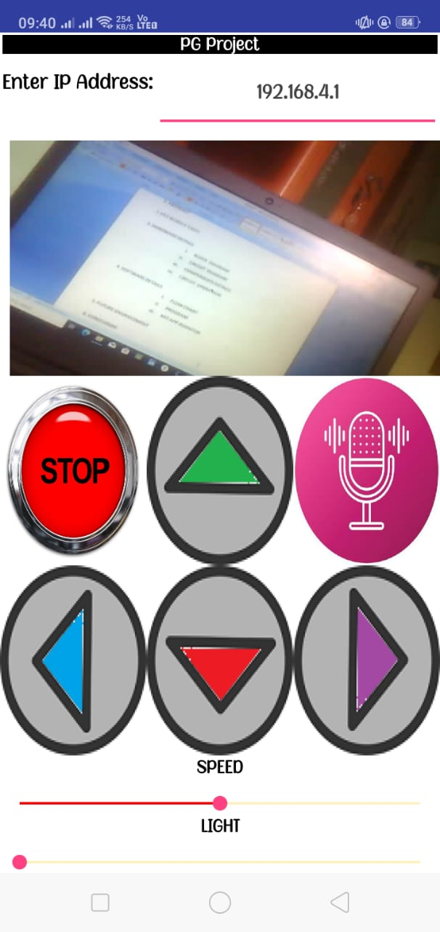
Application Using MIT App Inventor
The application for the Robot System is developed by using MIT App Inventor.
It is a web-based integrated development environment (IDE).
It allows for the creation of apps using a visual blocks language, making it easy to design and implement the user interface and functionality.
In this application, I’ve given button’s to control the robot like Forward, Backward, Turn Right, Turn Left, Stop and it will show the live streaming video that the robot capturing.
And also it have the Speed and Light controlling button’s.

Slide 9
Conclusion
1. ESP32-CAM Module Integration: The project successfully integrates the ESP32-CAM module as the visual core of the surveillance robot.
2. Custom Mobile Application: A custom mobile application enhances user experience by providing seamless manual control and advanced functionalities.
3. Real-Time Monitoring and Security: Demonstrates the potential for real-time monitoring and enhanced security through the ESP32-CAM's imaging capabilities.
4. Hardware and Software Innovation: The blend of hardware and software innovation exemplifies the project's success in pushing the boundaries of surveillance technology.
5. Potential Applications: Highlights potential applications of the ESP32-CAM Enhanced Surveillance Robot System in various real-world scenarios.

Slide 10
Future Enhancement
Autonomous Navigation
Implementing computer vision algorithms to enable autonomous navigation for the robot.
Advanced Object Recognition
Implementation of advanced AI algorithms to enable the system to recognize and track objects with higher accuracy.
Environment Sensors
Include additional sensors like temperature, humidity, or gas sensors to provide environmental data along with surveillance capabilities.
AI Based Behavior
Implementing AI algorithms to give the robot more behavior, such as recognizing specific people or learning and adapting to its environment.

Slide 11

Thank You!
For Spending your Precious Time.

